Slide 1
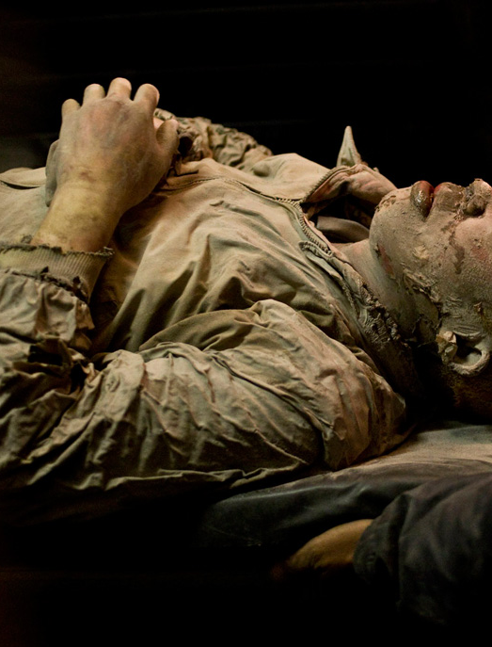
Victim: Adhi
As a Victim of a natural disaster, I would like to be able to be found quickly when another disaster occurs so that I am saved.
Goals:
Being found by 48 hours
Robot not scaring me in a vulnerable state

Slide 2
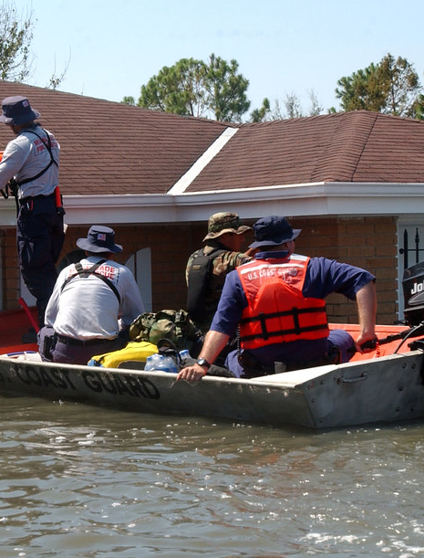
Search & Rescue : Dan
As a member of the search and rescue team I want to be able to find the any survivors quickly and efficiently, so I can save more lives.
Goals:
Have something to find the quickest routes to the victims quickly
Find victims
See the environment where the victims are in
Easy use of any programme

